Slide 1
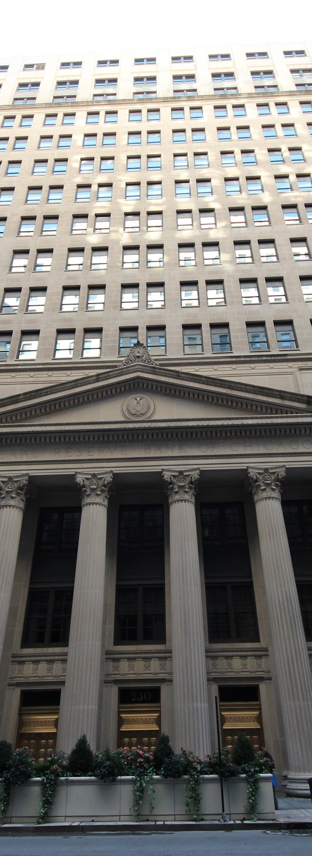


Fed Announcements
& the
S&P 500 during
COVID -19
Moses Devanesan, Mindy Bright, Casey Burke, Matthew Olentine Project 2

Slide 2

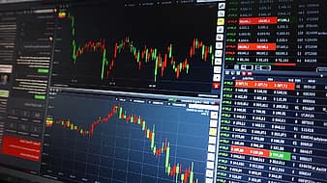
Scrape Federal Reserve COVID-19 related press releases (BeautifulSoup)
SpaCy and Vader to analyze and score sentiment
Use score to adjust trading algorithm

Slide 3
HTML IS CONFUSING

Slide 4
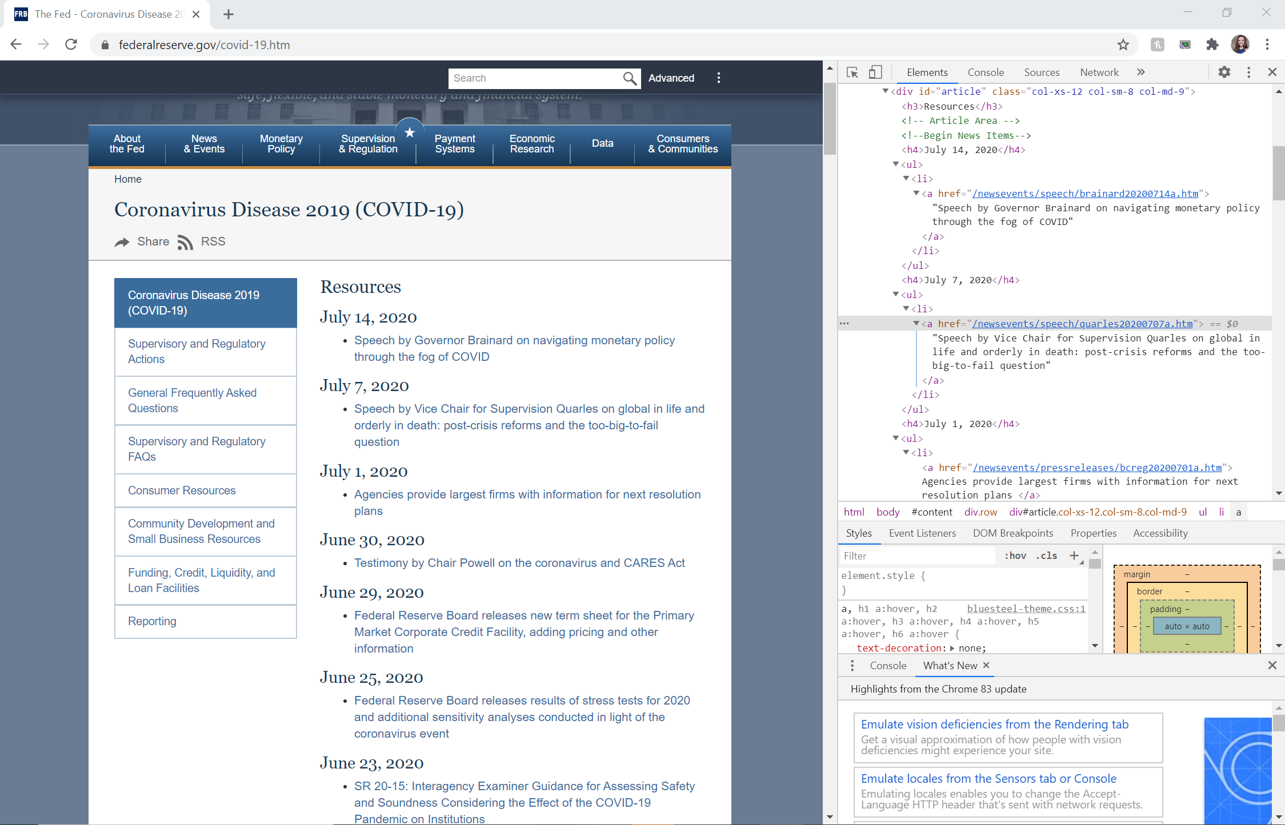
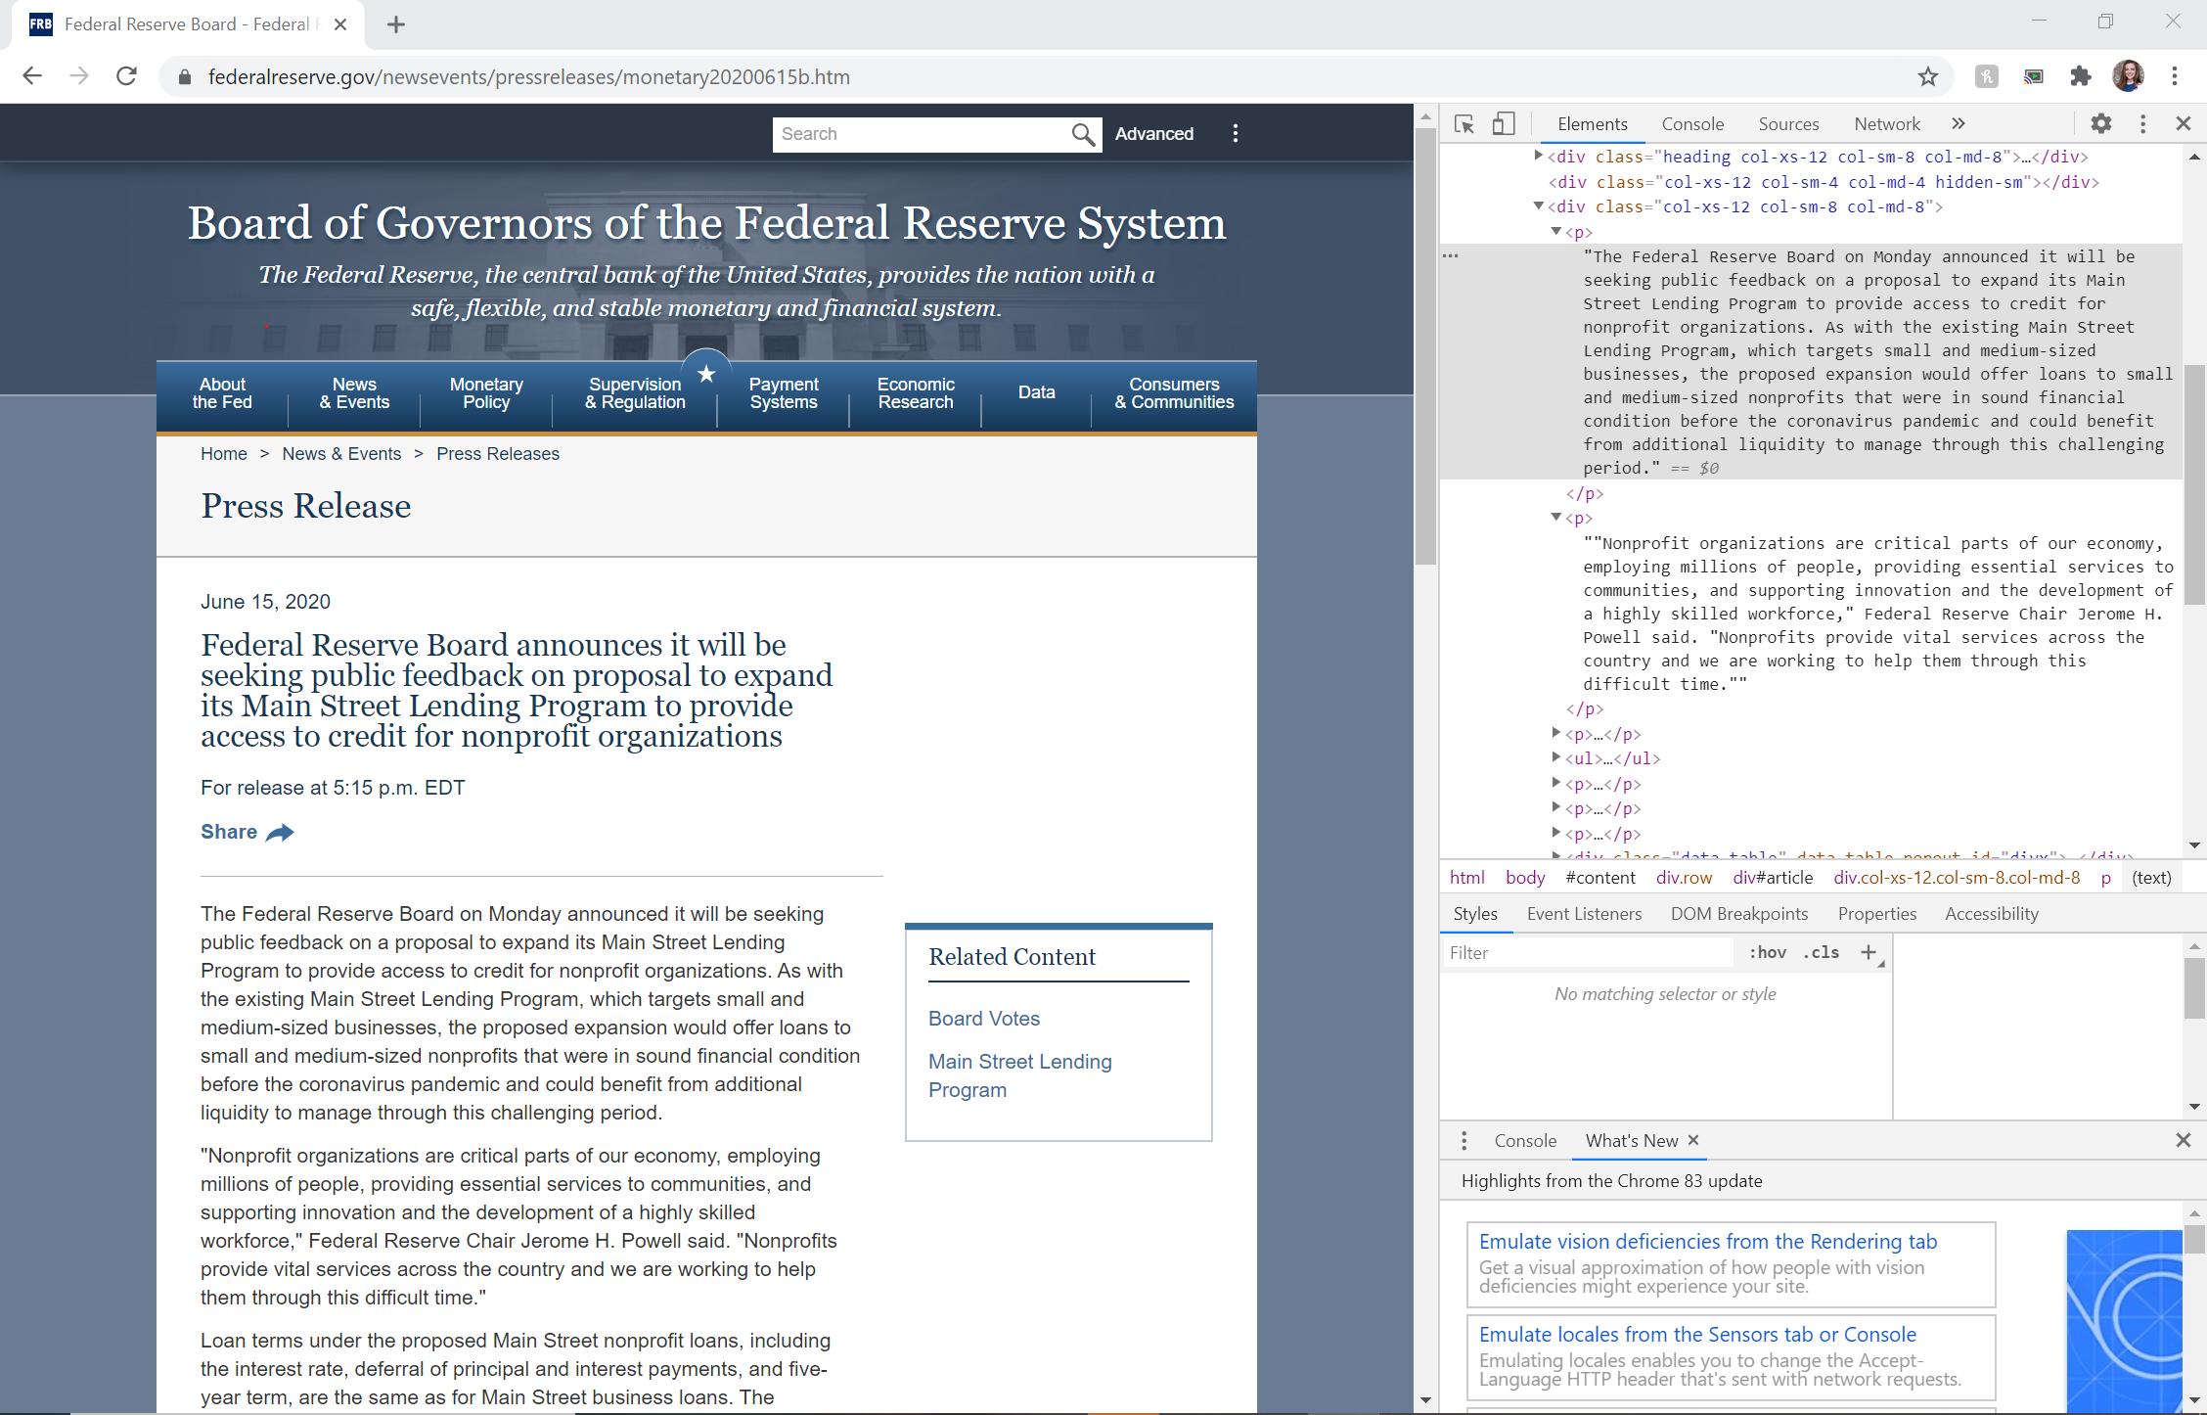
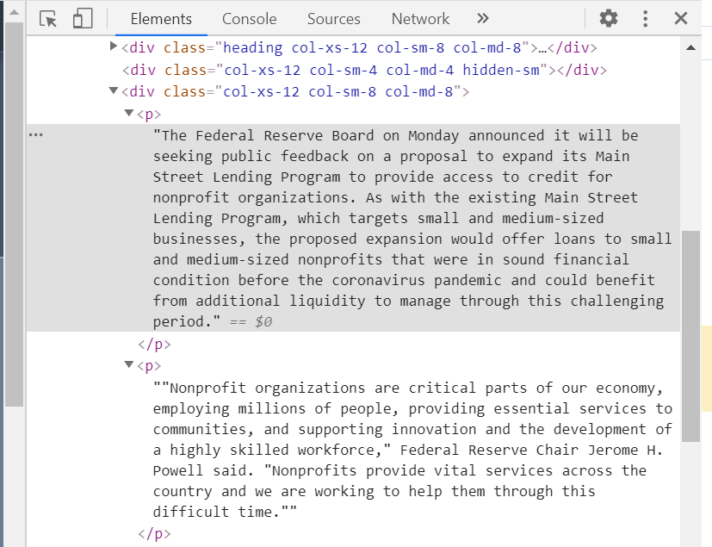

Notes:
Originally wanted to be able to scrape from the COVID page and have it link to individual articles
MESSSYYYYY + what in the world is HTML
Picked specifically ‘Press Release’ and ‘Joint Press Release’ articles to scrape
P values unlabeled
Caused a lot of confusion up front on how to scrape them from the HTML
Had to pull from <div>

Slide 5
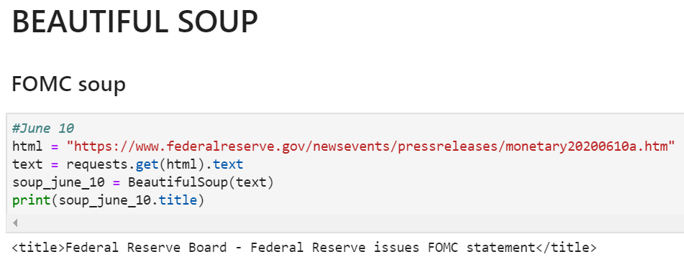
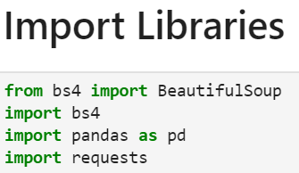
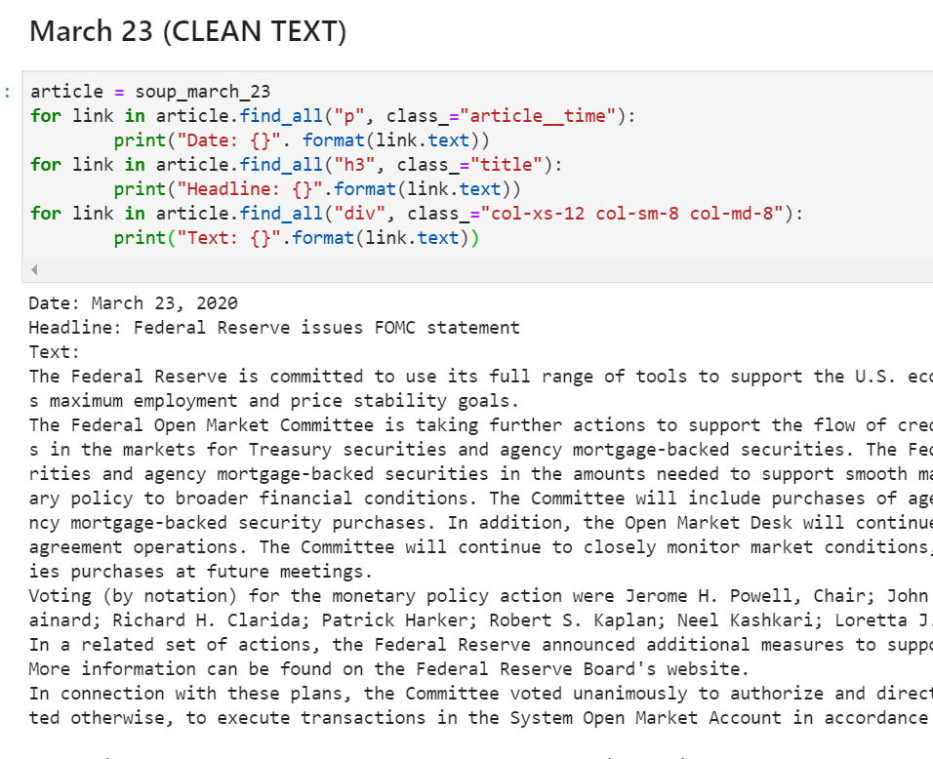
Beautiful Soup!
*Pulls data out of HTML and XML files for Python*
Notes:
Pulling HTML into python we used the Beautiful Soup library
Read HTML and XML files so python can read
For loop to find specific items in the article for sentiment analysis
Print format here allowed the text to come out extremely clean

Slide 6
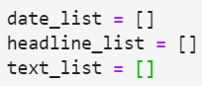
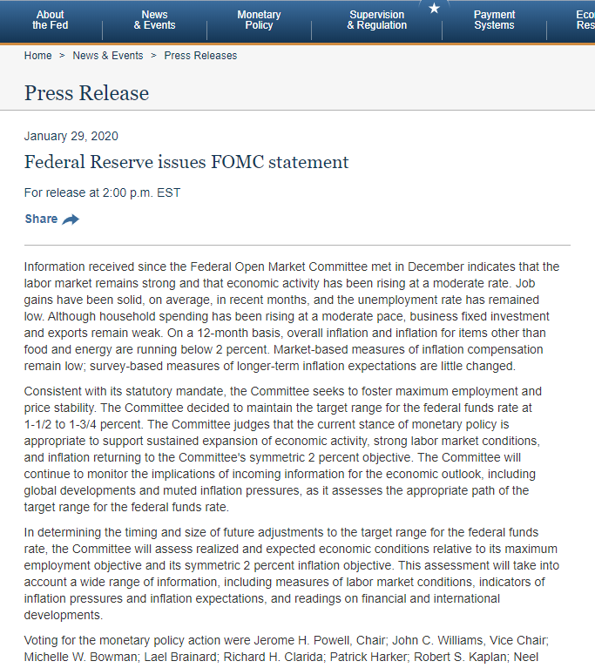
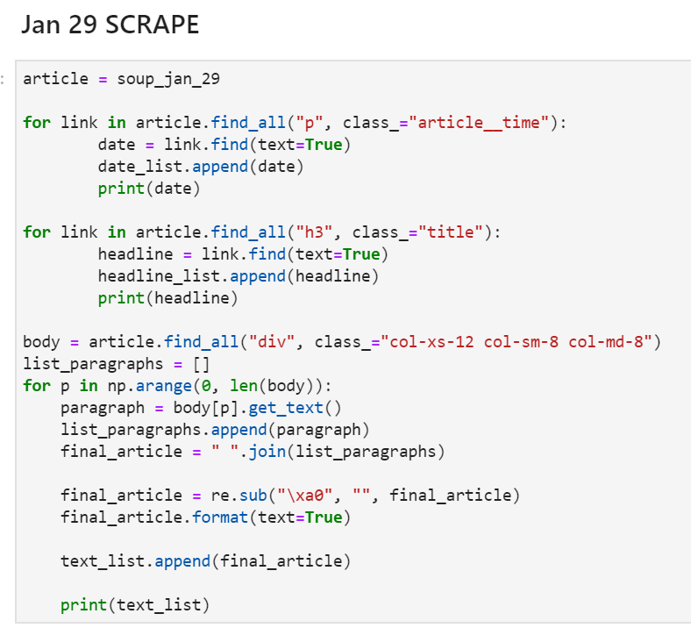
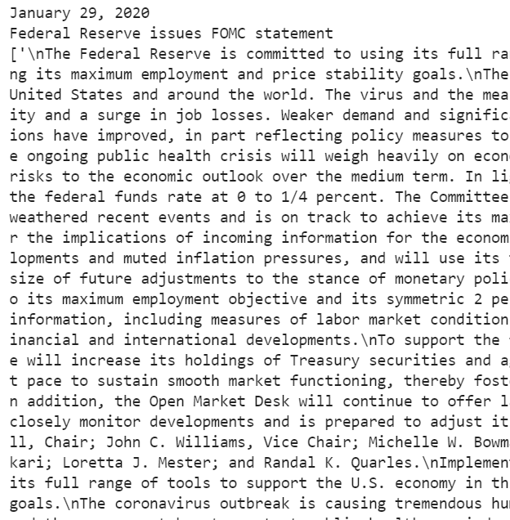
for loop into lists to build dataframe
Notes:
Where things started to get a bit messy!
Ran for loops to parse data into strings and then into the dataframe
Created variables to append into the lists
.FIND_ALL(<>, class_= “”) finds all the tags associated with the selected variables
.FIND(TEXT=TRUE) pulls only the text values out of the HTML code
Formatting the article paragraphs got a little messy
Each <p> tag is a section of text, in most cases with the Fed HTML a short paragraph
Where the find_all function comes into play
Finds ALL tags under the <div> tag with class of the col-xs-12……
So all of the <p> tags beneath
For some articles there are a lot of these <p> tags
The last for loop runs through all of the <p> tags and appends them to a single list.
Converts the p tags then into text
Appends them to a list (list of paragraphs)
Joins into one text block
Supposedly the re.sub(:LSKDFJ) should go in and pull out the “\n” (aka next line) tags.
Replace with “”
For some reason with the formatting it did not pull out these next line tags
Append new text block into the text_lists to be put into the dataframe

Slide 7
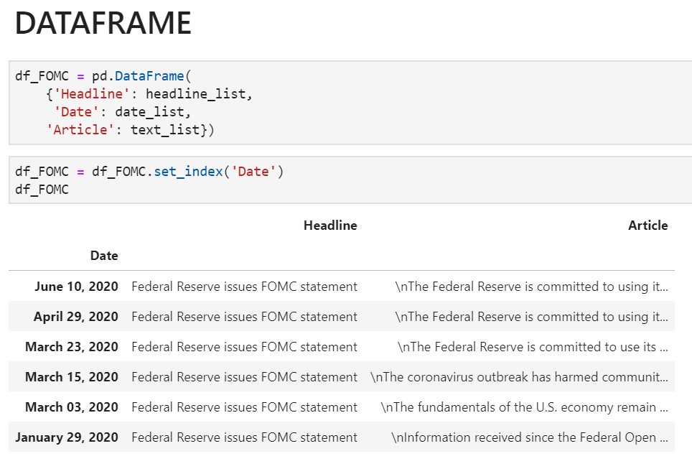
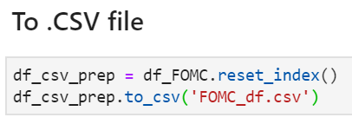
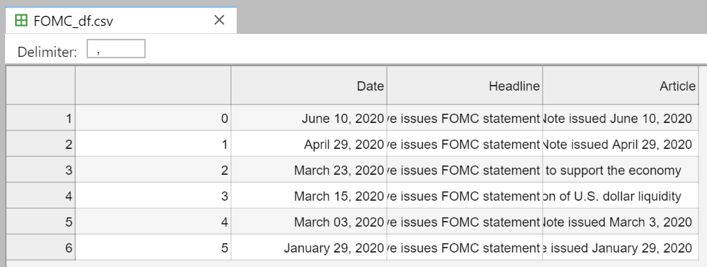
Notes:
Form a dataframe and send it off into .csv format
So it can be pulled into other notebooks for easy access and manipulation
For this specific DF I only scraped the Federal Reserve’s
FEDERAL OPEN MARKET COMMITTEE statements regarding COVID

Slide 8



Sentiment

Slide 9
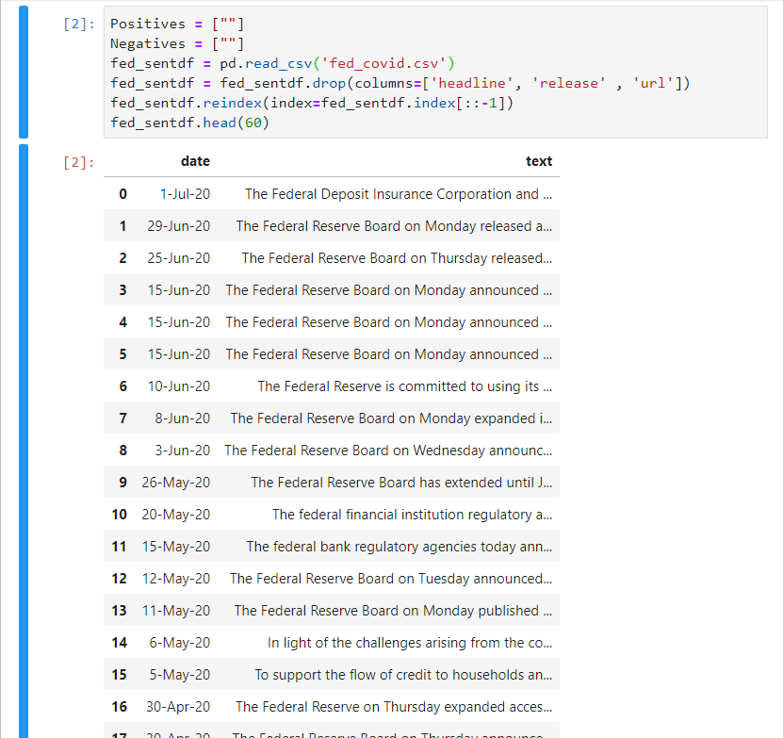
Created a dataframe from the csv file to display all the relevant information and text
Narrowed the dataframe to just include the dates and text of articles
Initially implemented our analysis through SpaCy with our own library of terms but decided to use VADER because of its robust data and what we believe to be more accurate sentiment scoring of our articles

Slide 10
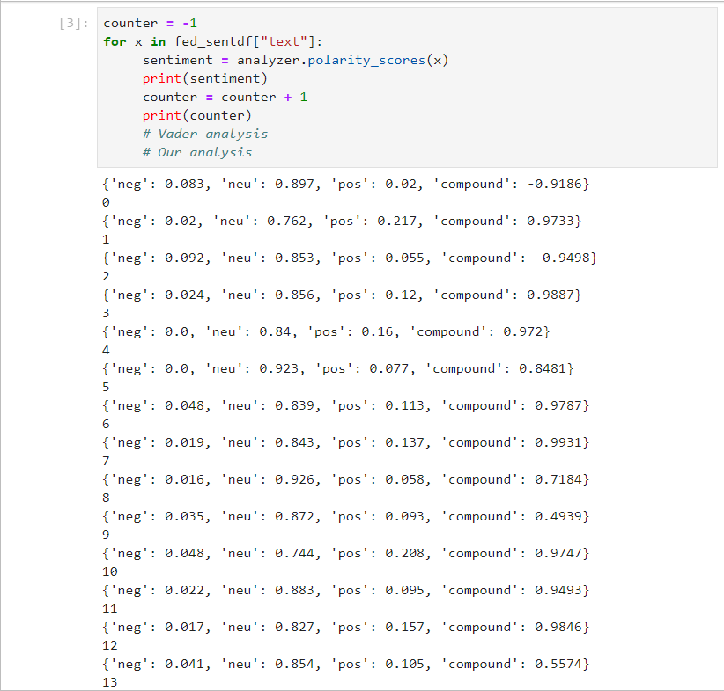
Used VADER to analyse Fed articles pulled in through the scraper
VADER sentiment analysis was used to:
Determine most sentiment from the text in each individual article
Provide trading algorithm with the dates of the articles with highest compounded scores, which then generates a buy signal*
*Note: Sell signals are generated by the crossing of 8 day and 20 day moving averages not sentiment

Slide 11
time to trade

